Slide 1
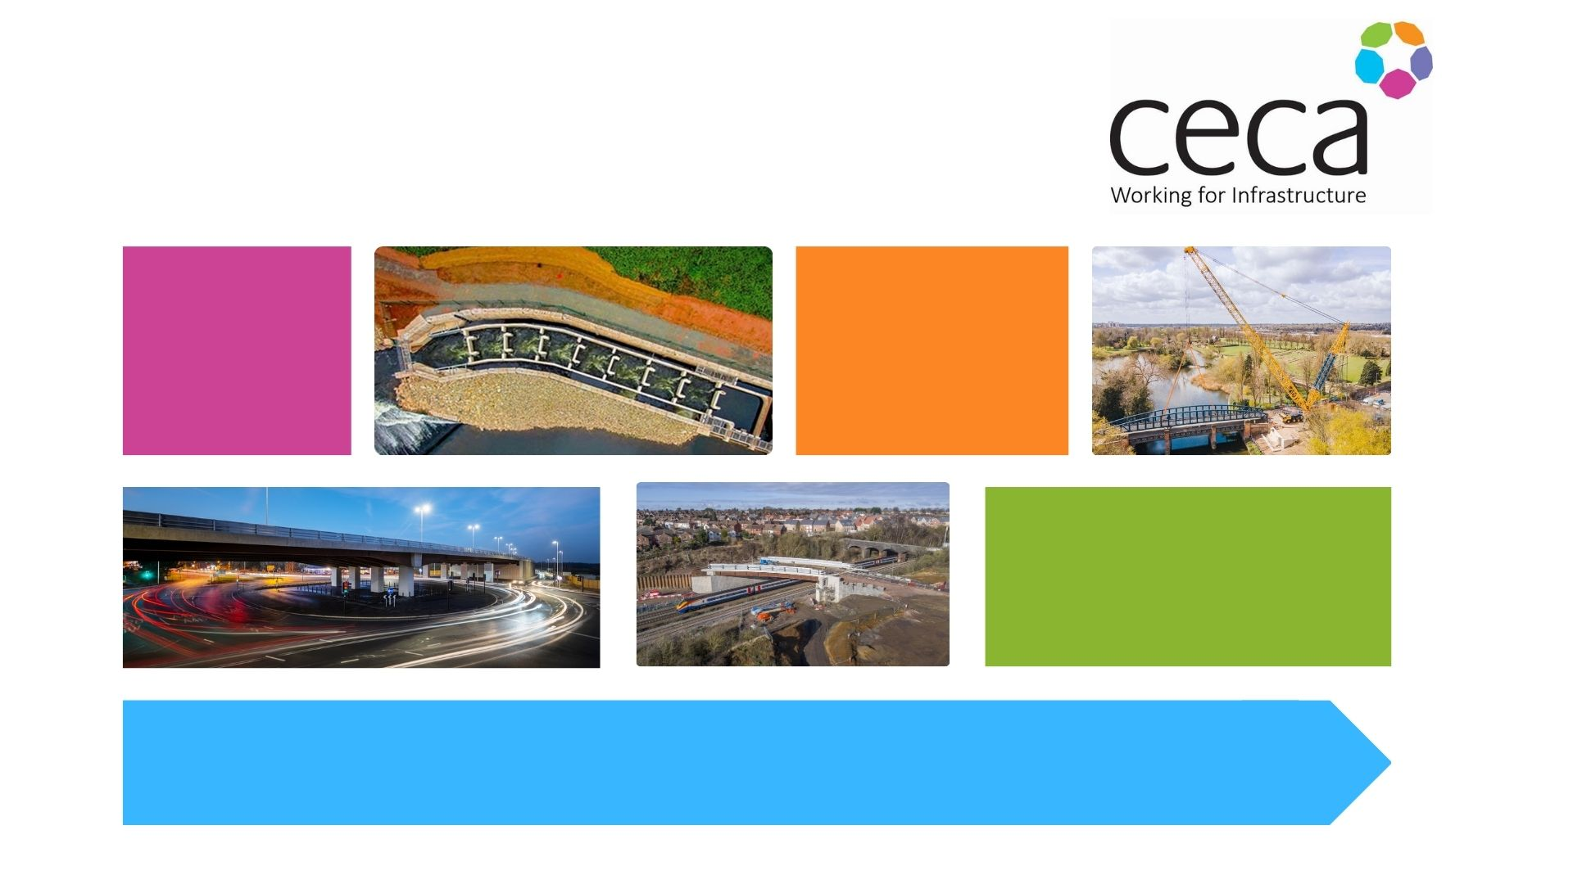
Introduction to Civil Engineering
Notes:
Welcome and introduction.
Introduce yourself, who you are, job role and company.
We are here today to share some information with you about Civil Engineering.

Slide 2

Aims
To develop an awareness and understanding of Civil Engineering.
To become familiar with terminology and identify the skills and knowledge required in Civil Engineering roles.
To examine day-to-day tasks and investigate how projects are planned and carried out.
To explore career paths and future progression within the role.
To think about the future of Civil Engineering.
Notes:
The aims of today’s session
Read through the bullet points and/or it can be summarised as
By the end of the session today you will have an understanding of civil engineering, become familiar with some terminology associated with Civil Engineering, know what skills and knowledge is required and know how to explore a career or find out about future opportunities should this be something that you would like to pursue.

Slide 3
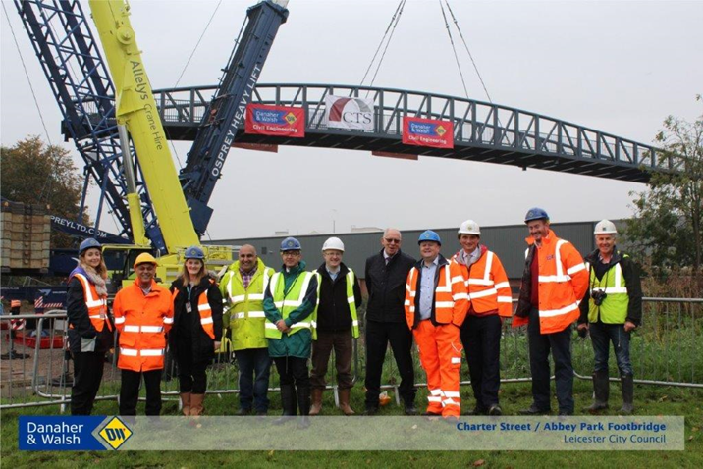
What is Civil Engineering?
Notes:
So, what is Civil Engineering? Who has heard of it before? What do you think it is?
Activity - Post it notes / discussion groups
Ask the pupils to discuss what they think civil engineering is and then write ideas and thoughts on post-it notes or whiteboard for discussion.
Share information from post it / discussion groups and discuss. Depending on the answers from the pupils you might need to provide further information / examples to help them understand what Civil Engineering is.

Slide 4
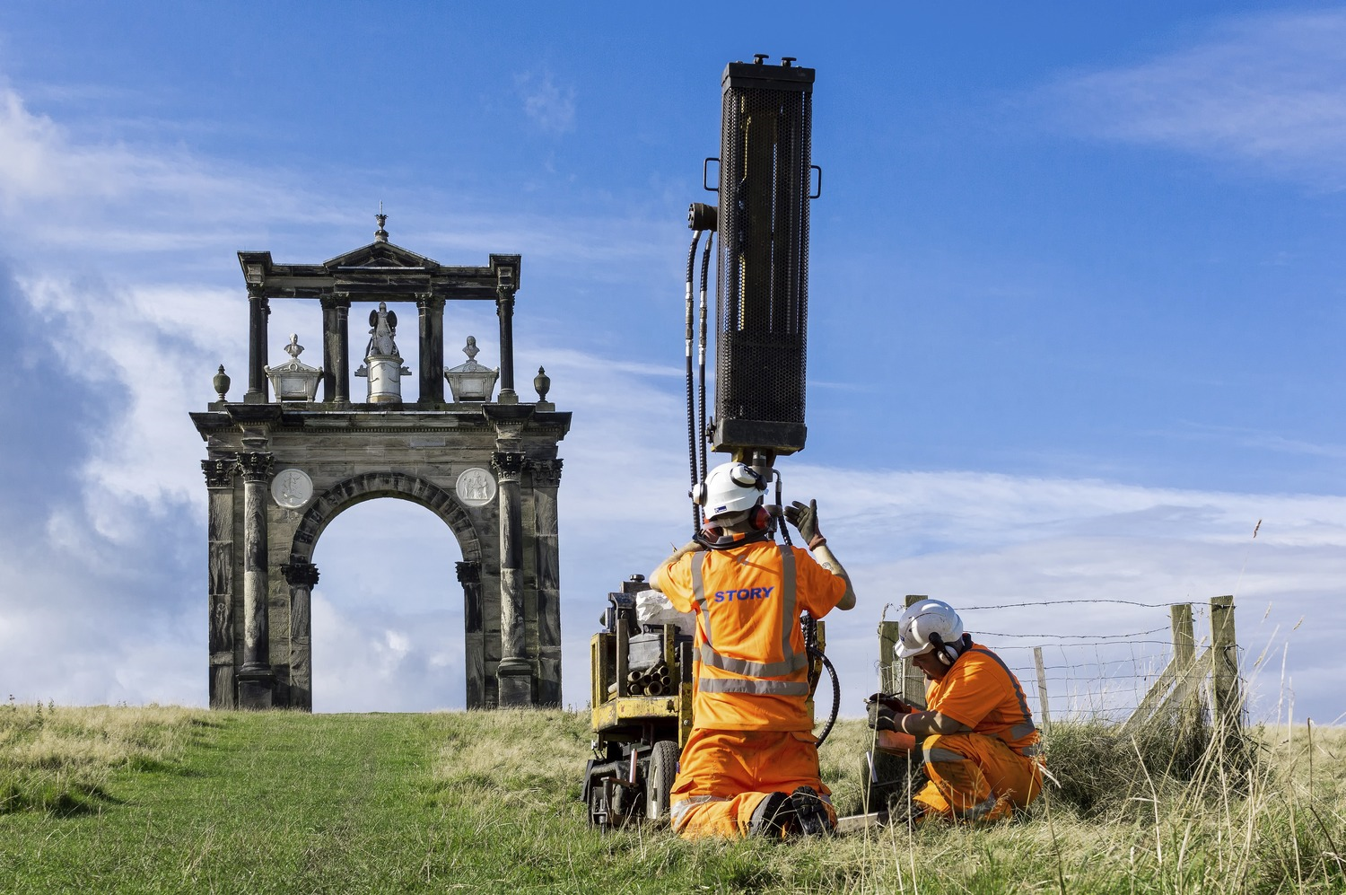

Civil engineering is……
A professional engineering discipline that deals with the design, construction and maintenance of the physical and natural built environment. This includes public works such as roads, bridges, canals, dams, airports ,sewerage, pipelines, structural components of buildings and railways.
Notes:
Read the definition
Civil engineering is the profession responsible for constructing and maintaining those structures and networks that ensure our quality of life, as well as protecting our environment. It can often be referred to as “infrastructure”
This includes bridges, transport links, and other major structures. There are three elements to the work;
Activities performed before the construction (including research, site investigations and design)
During construction (dealing with clients)
After construction (including maintenance)
Unlike other branches of the construction industry, most civil engineering work is not built for sale, it is to provide essential services.

Slide 5

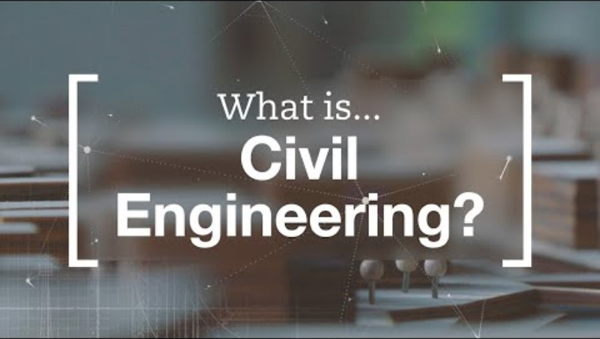
What is Civil Engineering?
Notes:
This is a short video and introduction to Civil Engineering.

Slide 6
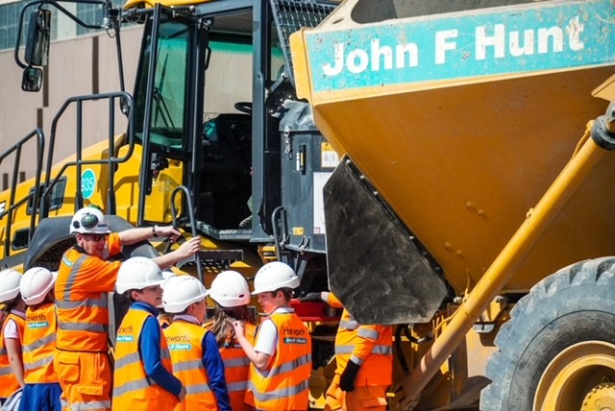
Civil Engineering Includes:
Highway Maintenance and Roads
Rail
Communications
Airports
Energy
Environment
Coastal and Marine
Water
Notes:
Now you all hopefully have a good idea about what Civil Engineering is. Civil Engineers mainly work in 8 key sectors
Highway maintenance and roads – including bridges, motorway and new road layouts e.g. the new motorway junctions (Maybe state a local project students may know of)
Communications – Cable laying – helping us to progress to fibre and 5g
Energy – this might include building electrical substation, or new nuclear power stations
Coastal and Marine – this includes creating effective and fit for purpose costal (sea) defences, protecting the marine life and the coastal environments
Railways – keeping current track maintained or new projects such as HS2
Airports- maintenance and extending runways
Environment- Protecting natural habitats- rewilding projects, renewable energy projects such as wind farms ad solar projects
Water – Flood defences, cleaning rivers- building new sewer systems to keep our water and rivers clean

Slide 7



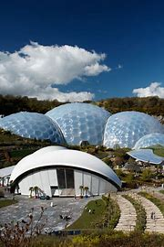
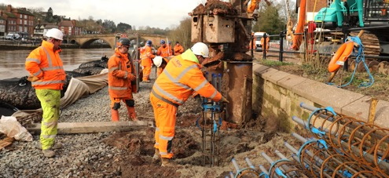
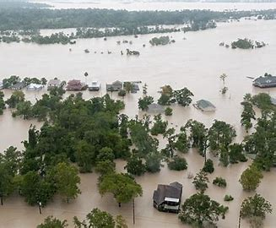
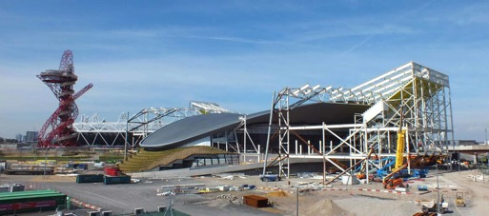
How do they help……
Connecting communities through bridges, train lines, canals and roads.
Access to nature and preserving natural habitats
The water we drink
Creating communities people want to live, work and play in.
Protecting our homes from flooding.
Responding to emergencies
Notes:
So now you know more about Civil Engineering, it might surprise you to know that civil engineers are often part of our everyday lives. Here are 6 ways civil engineers help you.
1. Connecting communities through infrastructure - A bridge, a train line and a canal - what do they all have in common? Yes, they help you get from A to B, but also for a lot of these structures, they solve the challenge of connecting communities. Civil engineers have to consider lots of factors. It is not as simple as just building a new road or bridge. They have to consider the impact on the environment, the design and materials that would be most appropriate, sustainability etc.
2. Water you drink – This includes looking after our sewerage system and working alongside water companies reduce the amount of energy it uses, thinking about new ways of introducing interventions that prevent clean water from mixing with dirty water and exploring new, nature-based solutions. The UK needs a long-term vision for water.
3. Preserve and protect habitats. In the more carbon-minded world we now live in, engineering is no longer about building the biggest, tallest, or longest structures, but rather the most sustainable.
The Eden project (in the picture). The project was built in 2001 in a reclaimed Cornish claypit. It won an award in 2002 for outstanding example of civil engineering. The build has created a temperature-controlled environment for an entire rainforest. The complex is dominated by 2 biomes. The biggest being 55m high (11 double decker buses on top of each other) Another interesting fact is the green tiles on the floor are made from Heineken beer bottles and the entrance mats are made from recycled truck tyres.
4. Protect our homes from flooding - Extreme weather events, such as flooding, are only going to increase as the world heats up due to climate change.
Civil engineers work hard to make communities more resilient to this challenge, by building protective flood defences
5. Creating communities for people to live, work and play in – e.g Civil engineers built a huge amount of infrastructure to support the Olympics - and the same happens in other countries that are new to hosting the Games and other major sporting events. But also have a life beyond the Games as tourist destinations.
6. Responding to emergencies .e.g When a natural disaster strikes, you might think of the blue light emergency services as the main people at the scene. However, civil engineers can have a critical part to play, whether that’s building the UK’s Nightingale hospitals at lightning speed during the Covid-19 pandemic, or reconnecting communities divided by earthquakes.

Slide 8
Routes into Civil Engineering
School
Sixth form or Further Education College
University
Apprenticeships
University Degree
A career in Civil Engineering awaits you
Notes:
So how do you get into Civil Engineering? It is important for everyone here today to know that the construction industry offers something for everyone.
Each job role will have different requirements and entry routes. Some entry level roles don’t require any qualifications at all – for others you may need to complete a relevant apprenticeship, college course or degree course in order to apply for the job.
Have a think about the type of roles that might interest you.
At School useful subjects would be maths, science (especially physics) DT and computing.
Sixth form and further education might offer A-levels, T-levels, HNC or HND or Foundation Degree.
Apprenticeships are available at all levels, including degree and graduate apprenticeships
At University you would most likely complete a Bachelors in Engineering.
Skills are often acquired over a period of time, so please do not worry. Simply having a passion for this work will be a good starting point. Exploring career paths and picking up skills as you go often leads to progression.

Slide 9
Career Path and Progression
Specialise in a particular engineering field or become a consultant
Work in research
Work with international development organisations or disaster relief agencies
Thinking about your future opportunities within civil engineering.
Continue with your professional development
Consider Chartered Engineering Status.
Notes:
There is lots of potential with a career in Civil Engineering. There will be opportunities to specialise in a particular field or become a consultant.
Work in research – this picture is of a robotic dog that helped to with this project
Work with international development organisations or disaster relief agencies.

Slide 10
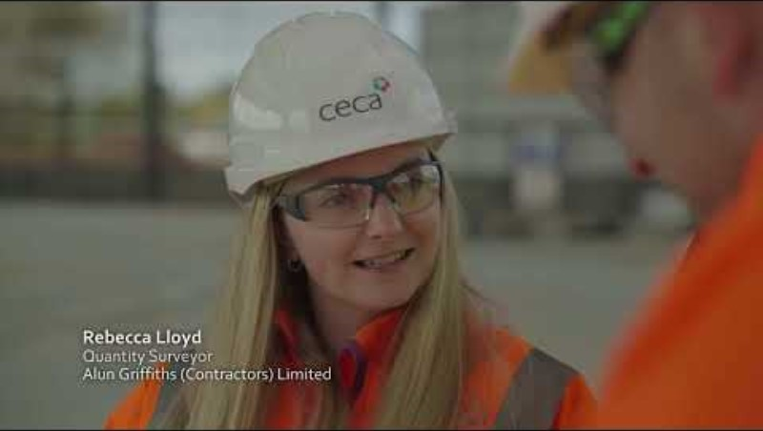
Notes:
This video has been produced by CECA Wales to provide some additional information about the roles and requirements of Civil Engineers.

Slide 11

Working closely with clients to understand what they need
Map and analyse data using mathematical modelling methods
Lead a team, co-ordinate work and manage a budget
Create design plans and models with computer software
Assess the risk and environmental impact of the project
Monitor the progress at each stage.
Day-to-Day tasks might include…….
Notes:
A day-in-the-life of a civil engineer would vary greatly, and it would depend on the project that you were working on. But it is likely to include a combination of these tasks.
You could also talk about a typical day in your company.

Slide 12
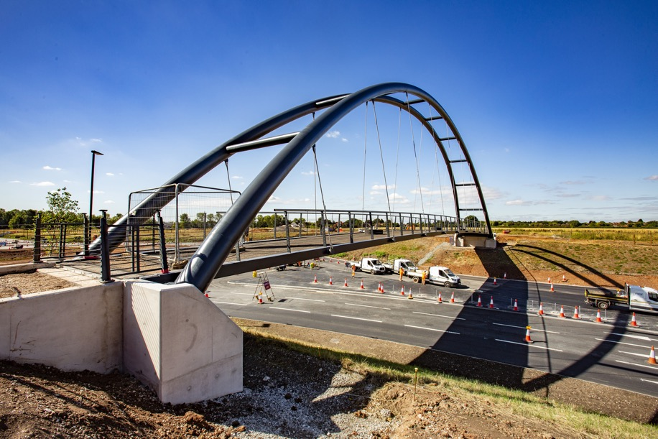
Activity
An exciting opportunity has arisen to re-energise a local community by connecting its town centre with the train station. They are hoping that with this new bridge, it will not only they are proud of their local area, and it is a vibrant place where people choose to visit, live, work and invest.
What would you prioritise?
How would you protect the local environment?
How would you reduce your carbon footprint?
Notes:
Now you know about more Civil Engineering, you now have an activity where you will take on this role. Think about what you have learnt and how to put it into practice.
You will be given a case study, Work in groups discuss roles and share ideas.
Work together to make decisions as a team about materials and ways to protect the environment, reduce your carbon footprint and create a sustainable bridge that will complement the community and provide positive opportunities
You will be pitching your ideas , about An exciting new infrastructure project that is going to connect a towns train station with the shopping centre.
Note to presenter – you can take as long as you feel for the activity – but would recommend 20- 25mins and feedback time. This may be a presentation or show of hands of what different groups did and why.

Slide 13
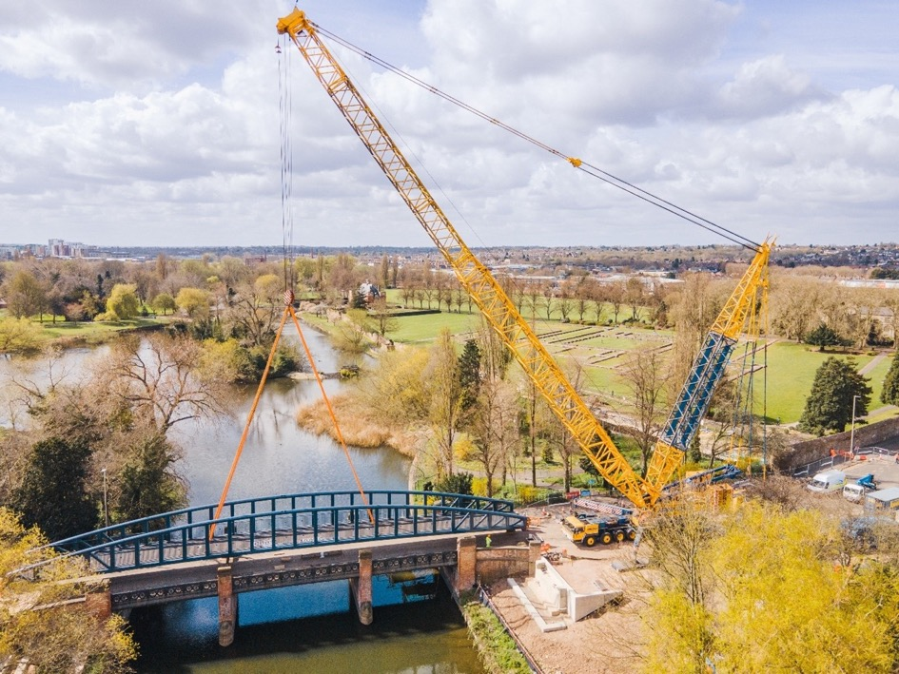
Activity
This new bridge needs to be state of the art, modern, fit for purpose but also be as environmentally friendly as possible.
Choose your job roles in your team
Decide on your bridge design, what materials you will use and why, how you will make your site as environmentally friendly as possible (what can you recycle).
Notes:
At the end of the activity – ask students to tell you their ideas- either as a presentation or discussion.
You may just want to collect the activities answers and give feedback which you leave with the teacher/tutor.

Slide 14


Quick re-cap
Who can remember what Civil Engineering is?
How many sectors are included in Civil Engineering?
What subjects might be useful to study if you would like to consider Civil Engineering in the future?
Can you remember one of the tasks you might need to do as a Civil Engineer?
What is the biggest challenge the Civil Engineering Industry faces in the future?
Notes:
Final thoughts for today. I wonder if any of you can remember the answer to any of these questions.
1. A professional engineering discipline that deals with the design, construction and maintenance of the physical and natural built environment. This includes public works such as roads, bridges, canals, dams, airports ,sewerage, pipelines, structural components of buildings and railways.
2. There are 8 main sectors
3. Science, maths, design technology, computer / ICT.
4. Create and design the project, lead a team, monitor the environmental impact, assess the risk and monitor the progress of the project.
5. They must work hard to reduce emissions.

